Slide 1





Comparative Study of Power Generation Methods for Mars Mission: Potential of Space Solar Power (SSP) System
Allied Universities Team:
Undergraduate students: Miles Johnson, Amy Li, Sean Rankin, Yohnei Shambourger, Vinay Simlot
Graduate students: Clark Esty, Reid Hyland, Joshua Rogers, Alex Walts, Zeyu Zhang
Faculty advisor: Paul Jaffe
Zeyu Zhang, Vinay Simlot, Sean Rankin
May 26, 2017
Present at International Space Development Conference (ISDC 2017)

Slide 2

Presentation Outline
Mars Mission Milestones
Surface Power Strategies: Surface Solar vs. Fission-Powered
Martian Space Solar Power (SSP) System Architecture
Wireless Power Transmission (WPT)
Proposed System Characteristics
Conclusions

Slide 3
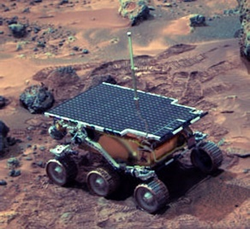
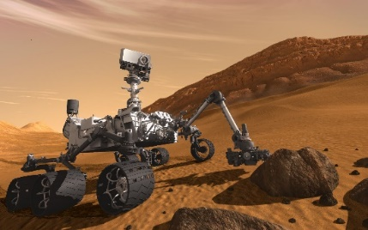

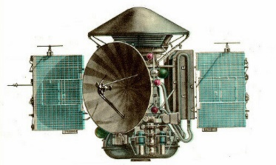
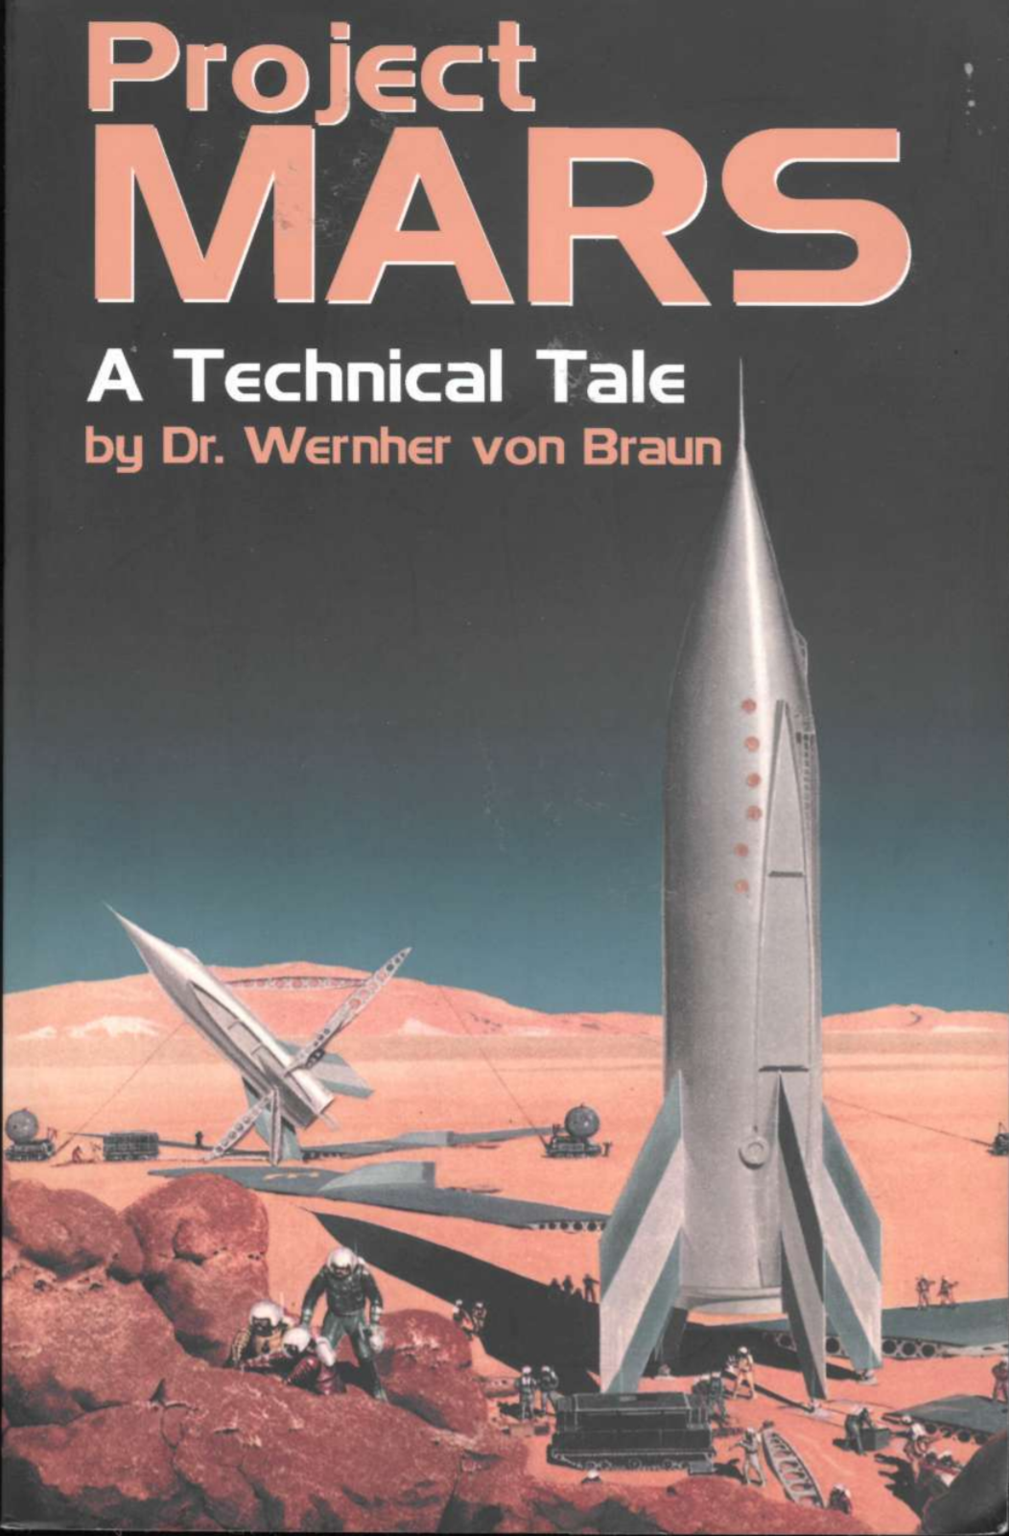
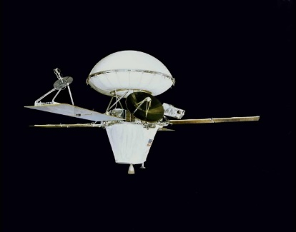
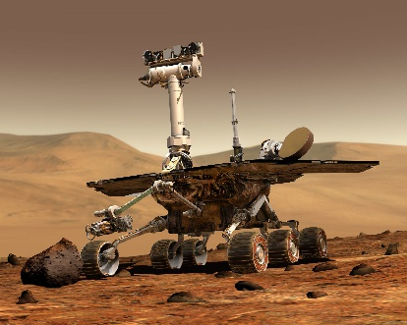
Mars Mission Milestones
Movie “A Trip To Mars”
Mars 2 and 3
“Sojourner”
“Curiosity”
1910
1970s
1997
2011
1948
1976
2004
Viking 1 and 2
“Spirit” and ”Opportunity”
First Mars Mission draft
Notes:
Project Mars: 35kW w/ steam boiler
Viking 1/2 : 4 solar panels, and radioisotope thermoelectric generators (620 W)
Sojourner – 200 PV cells, 16W of power at noon
Spirit and Opportunity: <1kWh per day with solar
Curiosity – nuclear thermoelectric generator with 110 W steady power

Slide 4
Mars Environment
Table 1. Martian Statistical Coefficients. ^{[1]}
Parameter | Value
Diameter | 6785km
Mass | 0.11 × Earth
Aerostationary orbit altitude | 17000km
Length of day | 24 hrs 37 mins
Length of year | 687 Earth days
Minimum distance from Sun | 205 million km
Maximum distance from Sun | 249 million km
Surface temperature | 174K to 308K
Gravity | 1 / 3 of Earth
Atmospheric pressure | 1 / 100 of Earth
Lower than Earth GEO
‘sol’
±20% light intensity
589W/m² orbital power density (average)

Slide 5
Mars Environment
The atmospheric composition (by volume) of Mars and Earth are shown ^{[1]} :
*Water vapor concentration on Earth ranges from 0.004% to 4%.
*Mars water vapor concentration is 1/1000 of Earth’s.
Notes:
Highlight CO2

Slide 6
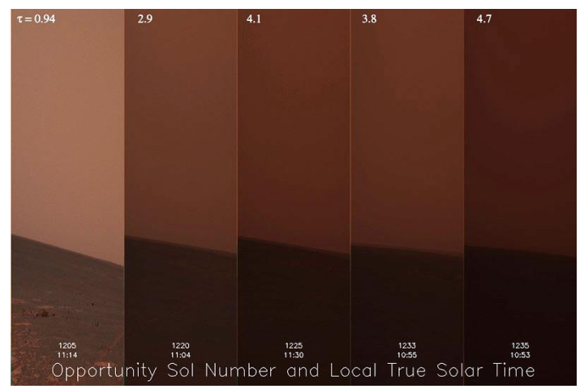

Martian Dust Storms
One of the most remarkable features of Mars.
Local dust storm: frequent, last for few days, modest change of τ (optical depth).
$$I=I_{0}e^{−τ}$$
($I$ and $I_{0}$ are the surface light intensity in a vertical path with and without a dust cloud, respectively.)
Global dust storm: Once in several years, last for months, large change of τ.
Dust can be lifted to 60km high and could cause light attenuation of 0.35.
τ = 0.94
2.9
4.1
3.8
4.7
Figure 1. Global dust storm observed by Opportunity rover ^{[2]}.
Notes:
Tau is optical depth on a scale of 1 to 5
Observed by opportunity over a period of 30 sols

Slide 7
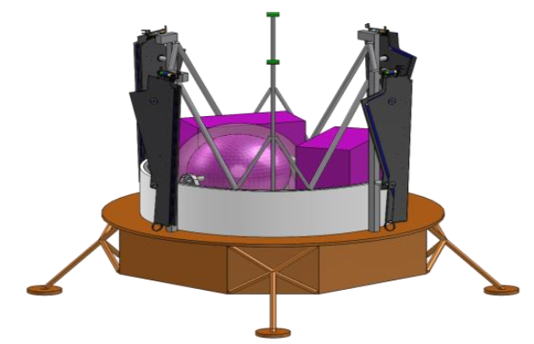
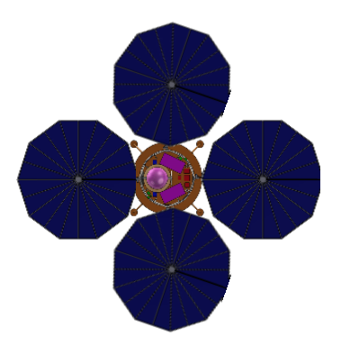
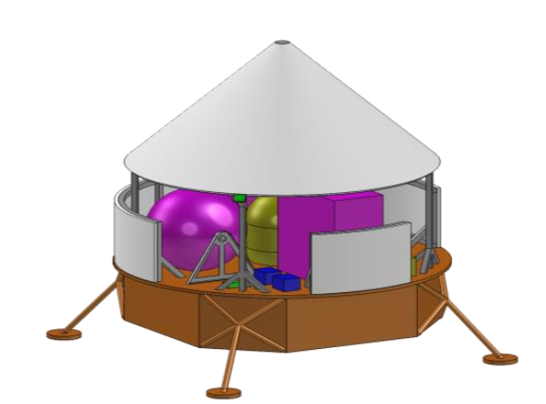
Traditional Surface Power Systems
By COMPASS team at John H Glenn Research Center
Surface Solar System
Equipped with 35% efficiency PV arrays.
Assume 120-day global dust storm with τ raised to 5.
12 hour daytime.
Panels periodically articulate +/- 45º to remove dust.
NASA/DOE Fission-Powered System
Equipped with radiation shield.
Reduce radiation to less than 3mR/hr within 500m.
Figure 2. Proposed Solar Array System. ^{[2]}
Figure 3. Proposed Fission System. ^{[2]}
Notes:
Transition ISRU

Slide 8
Traditional Surface Power Systems
ISRU System:
In-situ Resource Utilization (ISRU) converts CO₂ to liquid oxygen (‘LOX’).
Performance measured by ISRU rate.
Mission Categories ^{[2]}:
Uncrewed mission:
10.8kg/sol LOX generation
Crewed mission:
44kg/sol LOX generation
5 crews living on Mars for 500 days
7kW continuous power
35kW continuous power
14.829kW keep-alive power
Notes:
Keep alive power includes LOX production

Slide 9
Traditional Surface Power Systems
Table 2. System comparison in uncrewed mission. ^{[2]}
 | Surface Solar System | Fission-Powered System
Working condition | Assume continuous
Power | 16kW daytime (8kW average) | 7kW, continuous
LOX production rate | 10.8kg/sol | 10.8kg/sol
Power system mass | 2425kg | 2751kg
Solar array | 7.5m diameter, four panels | none
Cost | 328 million dollars | 428.3 million dollars
Notes:
Assume continuous
Talk about radiation shield
Talk about 8kW

Slide 10
Traditional Surface Power Systems
Table 3. System comparison in crewed mission. ^{[2]}
 | Surface Solar System | Fission-Powered System
Working condition | Assume continuous
Power | 35kW (10kW during dust storms) | 35kW, continuous
LOX production rate | 44kg/sol | 44kg/sol
Power system mass | 11713kg | 9154kg
Solar array | 12m diameter, four systems | none
Cost | 455.8 million dollars | To be determined

Slide 11
Mars SSP System Architecture
Power satellite is located in aerostationary orbit (17000km, 589W/m²).
Short eclipse: 1.28hr shadow (5% in one sol). (Ignore the shadow from ‘Phobos’)
Designed for crewed mission (35kW continuous power).
Use microwave to transmit power.
WPT Attenuation:
Free space, gaseous, dust

Slide 12

WPT: Free Space Attenuation
Friis’ transmission equation:
$$\frac{P_{r}}{P_{t}}=\frac{A_{t}A_{r}}{λ^{2}D^{2}}$$
Pt, Pr: Transmitted and received power; At, Ar: Antenna and rectenna aperture size;
λ: Microwave wavelength; D: Average distance between the antenna and rectenna.
Far-field constraint:
$$D>\frac{2d^{2}}{λ}$$
d: The antenna’s largest dimension.

Slide 13
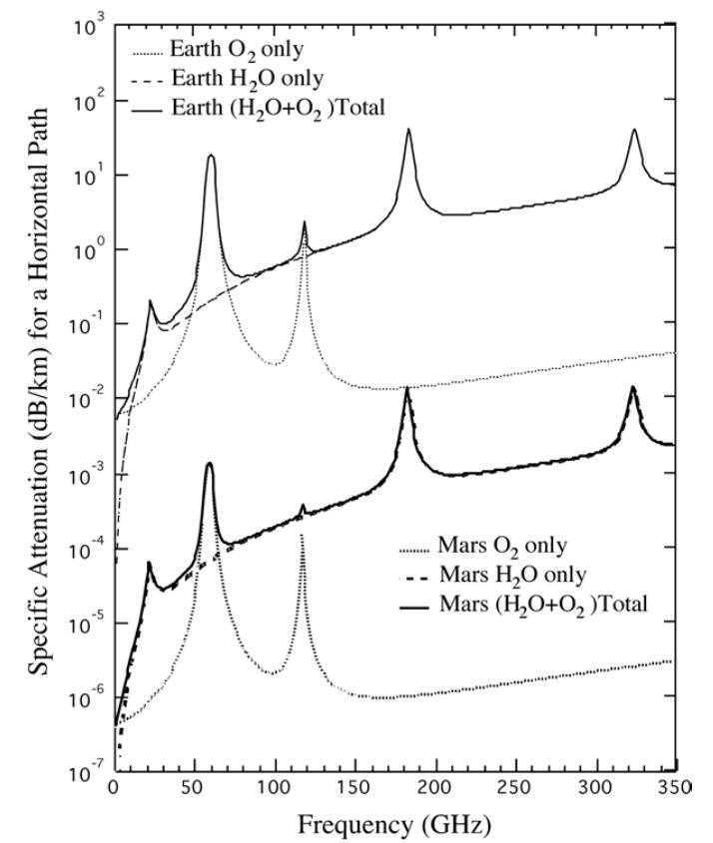
WPT: Atmospheric power loss
Gaseous attenuation
Permanent electric or magnetic moment could interact with microwave easily, such as in O₂ and H₂O.
Martian dominant gas CO₂ does not have such moment.
The amount of O₂ and H₂O is very low on Mars.
Consider 10km height of the atmosphere, the gaseous attenuation is around 0.001 to 0.01dB, which is negligible.
10³
10²
10¹
Earth
10⁰
10⁻¹
10⁻²
Mars
Attenuation (dB/km) for a Horizontal Path
10⁻³
10⁻⁴
10⁻⁵
10⁻⁶
10⁻⁷
Frequency (GHz)
Figure 4: Comparing gaseous attenuation for a horizontal path. ^{[1]}

Slide 14


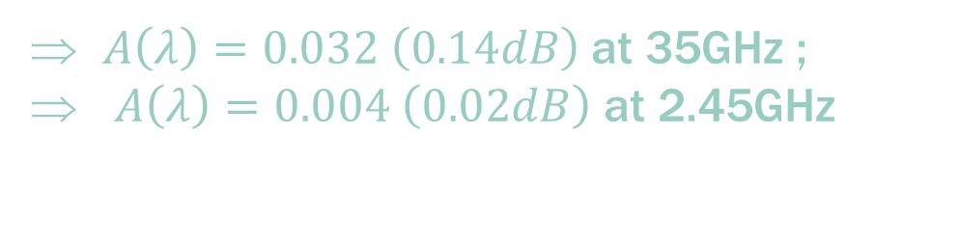
Atmospheric power loss
Dust attenuation
Absorption and Scattering
Sensitive to particle size
Dust size distribution
$N\left(r\right)=cr^{2}exp[−4{\left(\frac{r}{r_{m}}\right)}^{0.5}]$
r: radius of dust particles, distributed between 1 to 10μm.
Rayleigh scattering model
$A\left(λ\right)=\frac{3.087×{10}^{6}ε^{′′}N_{T}}{λ[{\left(ε^{′}+2\right)}^{2}+ε^{′′2}]}\int_{0}^{∞}{N(r)r^{2}dr}$
Permittivity: ε’ = 2.5 and ε’’ = 0.06 (at 35GHz) ε’ = 4.56 and ε’’ = 0.251 (at 2.45GHz)
Assume 4 μm average dust size, during global dust storm:
$A\left(λ\right)=0.032 \left(0.14dB\right)$ at 35GHz ;
$A\left(λ\right)=0.004 \left(0.02dB\right)$ at 2.45GHz

Slide 15
System Coefficients
Solar array mass density* : 5kg/m²
Antenna mass density: 4kg/m²
Table 4. Energy Conversion Efficiency. ^{[3,4]}
Process | 2.45GHz case | 35GHz case
Orbiter PV arrays | 35% | 35%
Orbiter DC-to-RF conversion η_{t} | 85% | 75%
Rectenna elements efficiency η_{r} | 91% | 73%
* Data from 120V Orbital ATK UltraFlexTM arrays

Slide 16

System coefficients
Mars orbit light intensity is 0.589kW/m². PV arrays have 35% conversion efficiency.
The goal is to achieve a 35kW electric power.
$0.589×A_{PV}×35\%×η_{t}×π^{2}{(\frac{d_{t}d_{r}}{4λD})}^{2}×η_{r}×(1−5\%)=35$
$A{d_{t}}^{2}{d_{r}}^{2}=1.6×{10}^{15}m^{6}$ (at 2.45GHz)
$A{d_{t}}^{2}{d_{r}}^{2}=1.1×{10}^{13}m^{6}$ (at 35GHz)
Also, free space attenuation is in positive correlation with ${d_{t}}^{2}{d_{r}}^{2}$.

Slide 17

System coefficients
$A{d_{t}}^{2}{d_{r}}^{2}=1.6×{10}^{15}m^{6}$ (at 2.45GHz)
$A{d_{t}}^{2}{d_{r}}^{2}=1.1×{10}^{13}m^{6}$ (at 35GHz)
Goal: Achieve minimum system mass and landed mass
System mass: $m_{system}=5A+π({d_{t}}^{2}+{d_{r}}^{2})$
Landed mass: $m_{landed}=π{d_{r}}^{2}$

Slide 18
System Characteristics
Table 5. Martian SSP system characteristics.
Parameter | 2.45GHz | 35GHz
Size of orbital PV arrays | 158490m² | 29203m²
Antenna aperture diameter | 500m | 215m
Rectenna aperture diameter | 200m | 90m
Distance | 17000km | 17000km
Received power | 35kW | 35kW
Landed mass | 126tons | 25tons
System mass | 1710tons | 317 tons

Slide 19
Thoughts
Although Martian SSP system could weigh as much as several hundreds of tons. But one has to consider:
Based on the development of propulsion techniques, transporting large mass hardware to Mars will become practical.
A continuous, stable and low risk power can be generated using achievable technologies.
It has over 20-year lifetime. Once deployed, it can be applied for different missions, due to the flexibility of the power beaming.

Slide 20
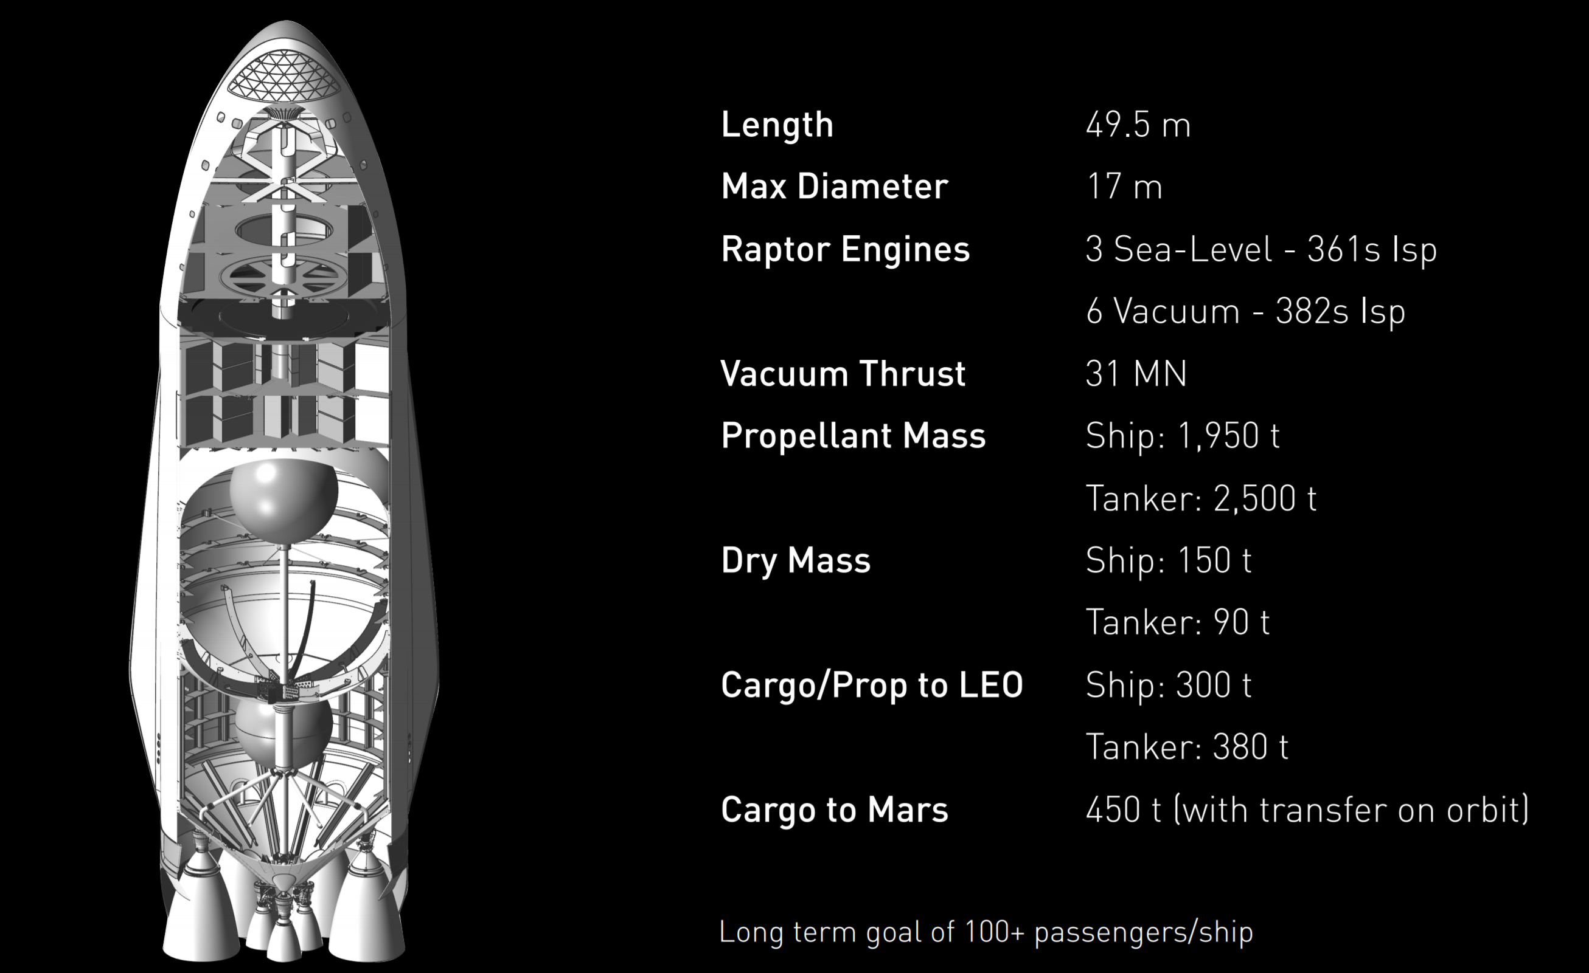
Propulsion system in the future
SpaceX interplanetary mission

Slide 21
Thoughts
Although Martian SSP system could weigh as much as several hundreds of tons. But one has to consider:
Based on the development of propulsion techniques, transporting large mass hardware to Mars will become practical.
A continuous, stable and low risk power can be generated using achievable technologies.
It has over 20-year lifetime. Once deployed, it can be applied for different missions, due to the flexibility of the power beaming.

Slide 22
Thank you!

Slide 23
References
[1] Ho, Christian, Nasser Golshan, and Arvydas Kliore. "Radio wave propagation
handbook for communication on and around Mars." (2002).
[2] Rucker, Michelle A., et al. "Solar Versus Fission Surface Power for Mars." (2016).
[3] Cougnet, Claude, et al. "Solar power satellites for space applications." Journal of the British Interplanetary Society 59 (2006): 290-296.
[4] Jaffe, Paul, and McSpadden, James. "Energy conversion and transmission modules for space solar power." Proceedings of the IEEE 101.6 (2013): 1424-1437.

